Slide 1
15 years on the bottom rung
Lesson 7
February 9, 2015

Slide 2
Warm Up 2-9-15
How do you feel on the debate of illegal immigrants in America?
  Why is there such a debate over the legality of immigrants?
Objective: Students will read an article and view videos, graphs, and political cartoons in order to write a well-informed persuasive essay on immigration.
EQ: How do current immigration laws affect me?

Slide 3
R1: Immigrants & Class
Are they doing anything to decrease the class divide?
  What types of jobs do you think they are forced to do?

Slide 4
R2: Agree/Disagree? Explain
“Mexicans say they feel, that the illegal immigrants “are doing the work that not even the blacks want to do in the United States.”
“They will be better off than they could ever have been in Mexico,” he said, “but I don’t think that’s going to be enough to prevent them from an underclass in New York.”
  Do you think illegal immigrants are creating a new lower class?

Slide 5
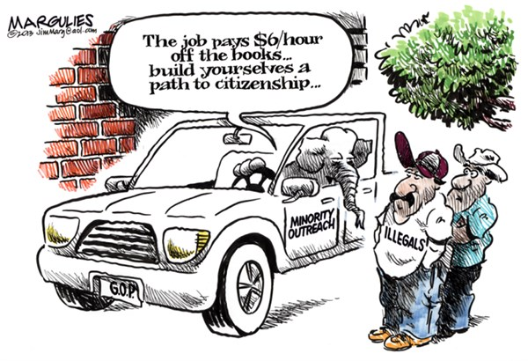
A1:Is this immigration reform?

Slide 6
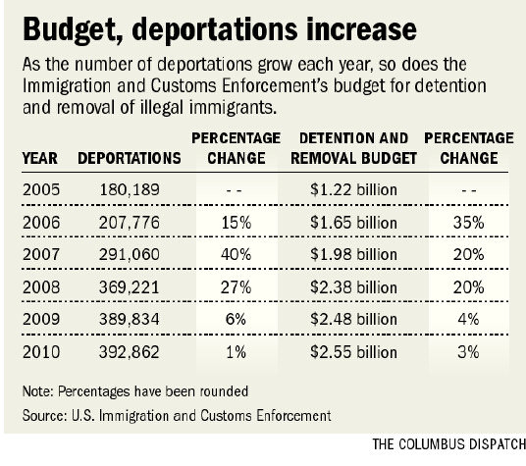
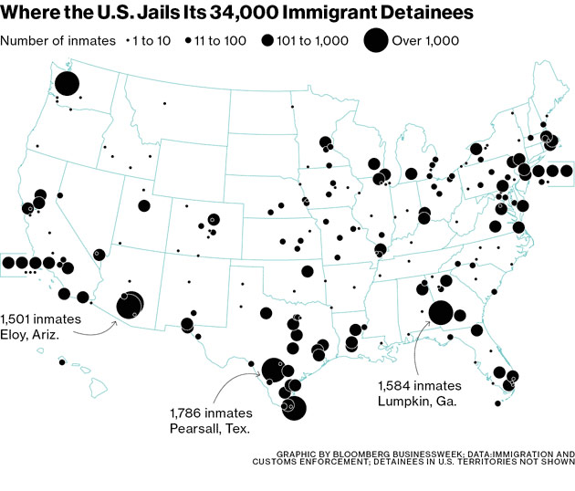
A2:Ethics: should they matter?
Illegal children are allowed to stay while parents are deported.

Slide 7
R3:Different Results
Consequences have been doled out to the illegal aliens, but what should happen to Zannikos? Is he doing more good than harm? Make a T=chart listing pros and cons to his business model.

Slide 8
Should we stop/help them?
One story: Omar Nelson Chilel Lopez
  Does this article aim to influence readers to side with the immigrant? What specific word choice helps you come to this conclusion?

Slide 9
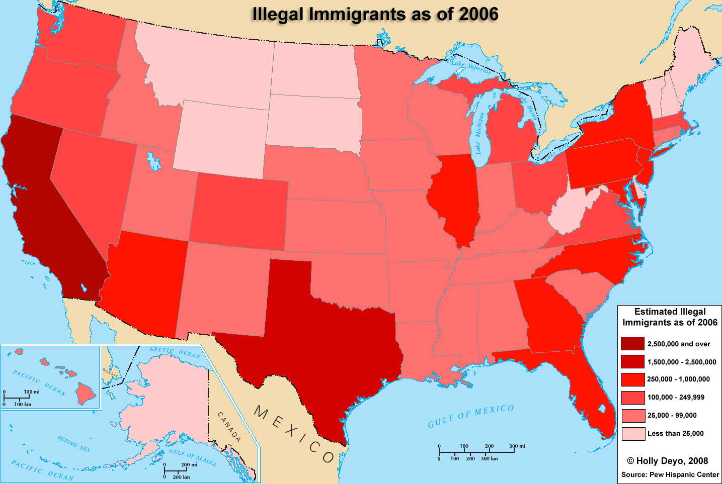
A3: What inferences can you make about this map?

Slide 10
R4:A Divisive Issue
Create a T-Chart; labeling one side Hopes and the other Realities,
Watch clip from Which way Home and read pgs. 119-124, recording information appropriately.
  Is it worth it? If so, what can we gather about their life back “home”?

Slide 11
What about us?
Education opportunities: Are they taking my rights away?
  What should happen when it comes to education? Should good students be able to stay? How does this fair in the role of class?

Slide 12
A Long Day Closes
Exit Ticket:
  Zannikos, an immigrant himself, was able to move up in class through America’s mobility. Because we know of the struggles immigrants go through, and how acutely aware he is through his own personal experience, what does this article tell readers? Think about Zannikos’ treatment of the Mexican workers and information we learn at the end.

Slide 13
Movie
We will now watch an independent foreign film with subtitles, Sin Nombre (Without name).
While this is a work of cinema, there is an abundance of truth to it.
Task: Write a 750 word response to the film and the debate on immigration. Specific examples from film along with two pieces of textual evidence are required.

